Slide 1

Case study : How Does a Bike-Share Navigate Speedy Success?
Author: Ladislau André
Junho 2022

Slide 2
Problem:
Solution:
Design marketing strategies aimed at converting casual riders into annual members. In order to do that, the marketing analyst team needs to better understand how annual members and casual riders differ, why casual riders would buy a membership.
Lauching new attracting marketing campaign for casual riders, as well as offers to annual members to increase their ride duration;
Make special discounts for those months and days where there are less rides.

Slide 3
Analytical goals
WHY: Would casual riders buy Cyclistic annual memberships?
HOW: Annual members and casual riders use Cyclistic bikes differently?

Slide 4
Analytical goals
WHY: Would casual riders buy Cyclistic annual memberships?
HOW: Annual members and casual riders use Cyclistic bikes differently?

Slide 5
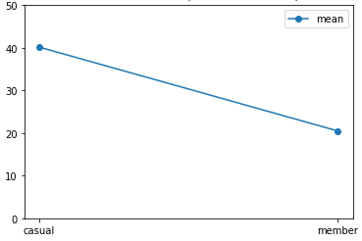
Average ride length greater
Casual riders have an average ride length greater than annual members.

Slide 6
Casual
268 363
Members
Average ride length greater
Diving deeper into our analysis we could find out that in the weekends the ride length in seconds for casual are higher than for members using the docked bike.
Count of ride length in sec
230 831
210 787
191 051
Saturday
Sunday
Docked Bike
Source: Average test scores from 2004-2018 annual state mandated tests at the end of the year (n=160 students)

Slide 7
Analytical goals
WHY: Would casual riders buy Cyclistic annual memberships?
HOW: Annual members and casual riders use Cyclistic bikes differently?

Slide 8
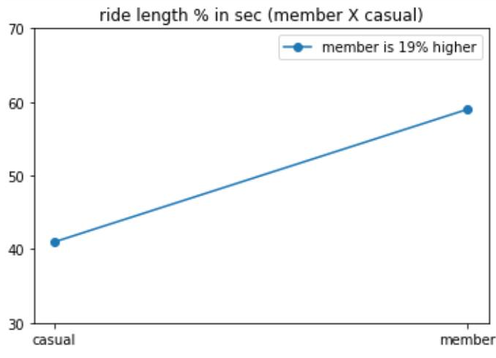
Percentage of ride length distribution
Annual members perform a higher ride length distribuition than casuals riders.

Slide 9
15 657
Casual
A curious difference about docked bike per month
The first month of 2021 the docked bike was used only once and the next two months it was not used by the annual members, differently from the casual riders.
Count of ride length in sec
Members
2 105
1 271
1
0
0
Jan
Feb
Mar
Docked bike in 2021

Slide 10
In Summary
WHY:Casual riders perform higher distances than annual members and have greater appearance in weekends, therefore iwith the right campaign they might be transformed into annual members
HOW: Launching specific marketing campaigns for casual riders, making these campaigns even more intense in the weekends where casual have greater appearance.

Slide 11
Thank You.

